Slide 1
SCENARIO-BASED TESTING (SBT) OF EMBEDDED SYSTEMS
RAMESH S. & ARUN A.
CS 522 – EMBEDDED SYSTEMS | IIT-G
OCTOBER 26, 2023

Slide 2
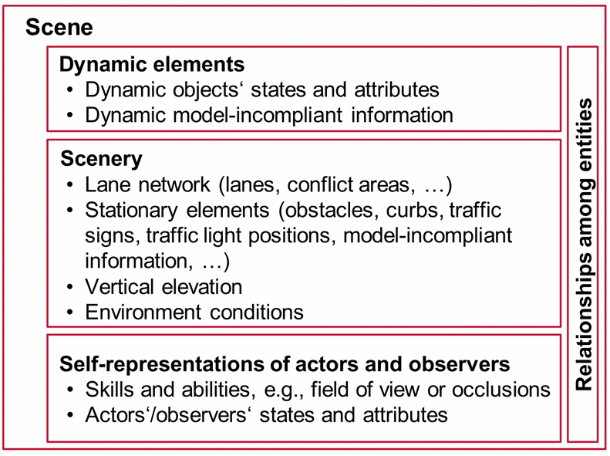
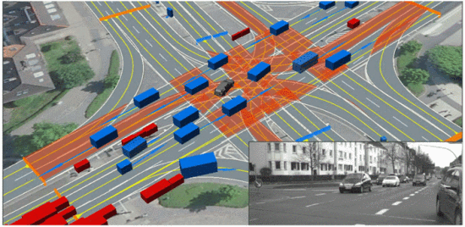
SCENE
A scene describes a snapshot of the environment including the scenery and dynamic elements, as well as all actors’ and observers’ self-representations, and the relationships among those entities.

Slide 3
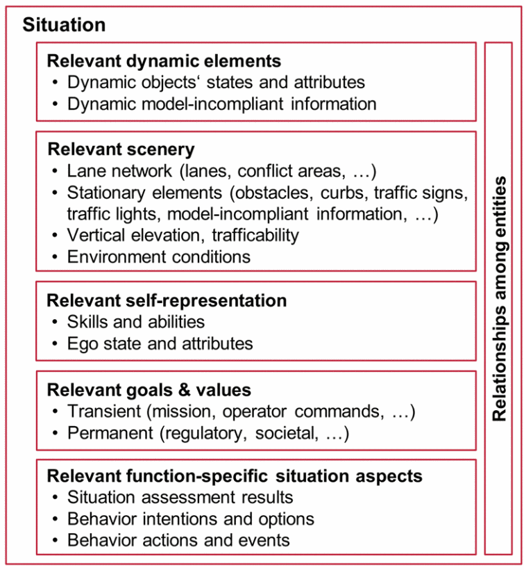
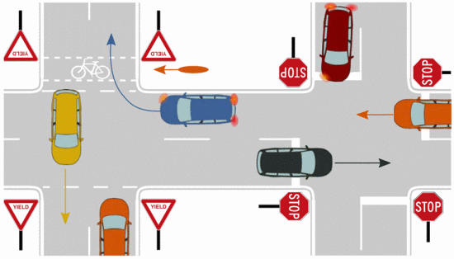
SITUATION
A situation is the entirety of circumstances, which are to be considered for the selection of an appropriate behavior pattern at a particular point of time. It entails all relevant conditions, options and determinants for behavior.

Slide 4
SCENARIO
A scenario is a temporal sequence of scenes
A scene is a snapshot of the environment including the scenery and movable objects, as well as actors’ and observers’ self-representations, and the relationship among those entities
Scenario abstractions:
Abstraction Level | Description | Example
Functional | A qualitative verbal description | The ego car drives on a straight road at a high speed
Logical | Set of parameter ranges and potentially with distributions | The ego car drives at a speed between 10 m/s and 20 m/s
Concrete | A set of exact parameter values | The ego car drives at 15 m/s

Slide 5
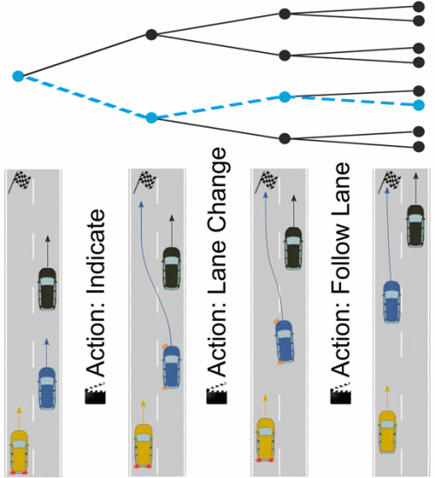
SCENARIO

Slide 6
SBT IN UNMANNED AERIAL VEHICLES (UAVs)

Slide 7
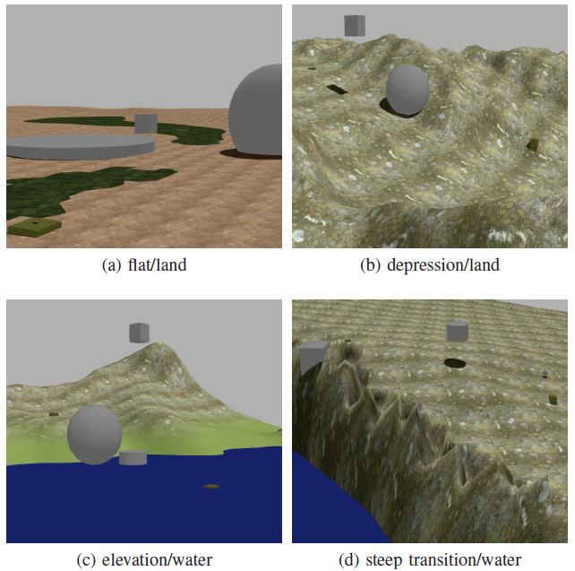
UAVs - EXEMPLARY OPERATING CONDITIONS

Slide 8
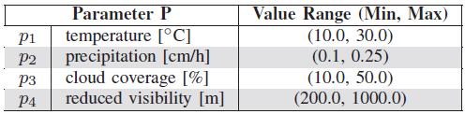
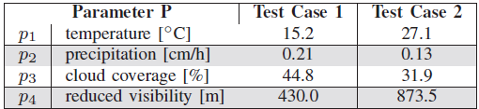
LOGICAL VS CONCRETE SCENARIO

Slide 9
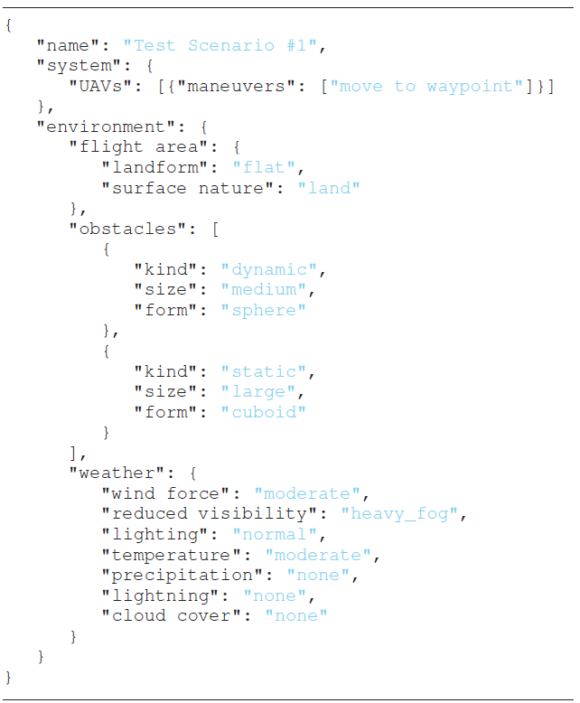
FORMAL DESCRIPTION

Slide 10
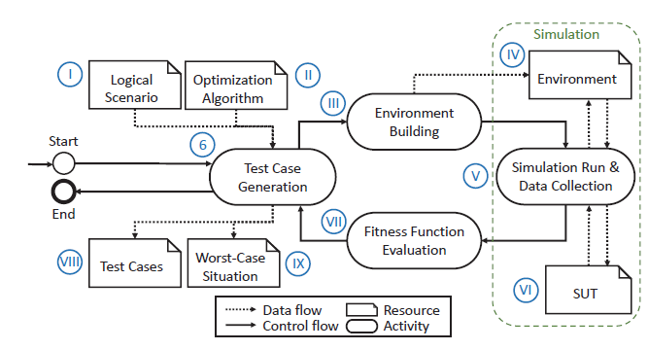
SIMULATION-BASED OPTIMAL TEST GENERATION

Slide 11
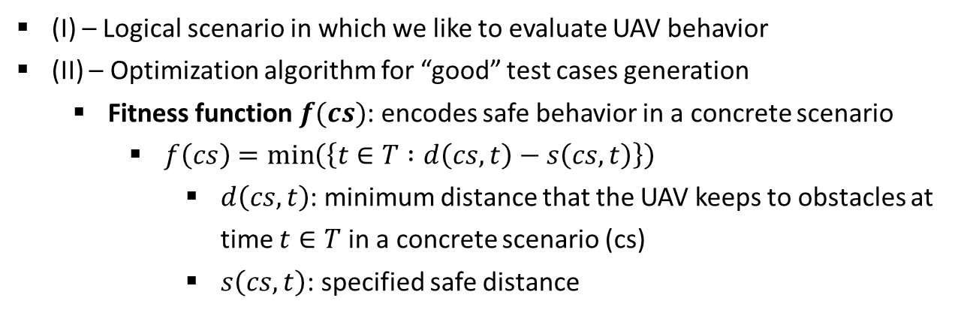
SIMULATION-BASED OPTIMAL TEST GENERATION
(I) – Logical scenario in which we like to evaluate UAV behavior
(II) – Optimization algorithm for “good” test cases generation
Fitness function $f(cs)$: encodes safe behavior in a concrete scenario
$f\left(cs\right)=\min\left(\left\{t∈T :d\left(cs, t\right)−s\left(cs,t\right)\right\}\right)$
$d\left(cs, t\right)$: minimum distance that the UAV keeps to obstacles at time $t∈T$ in a concrete scenario (cs)
$s\left(cs, t\right)$: specified safe distance

Slide 12
SIMULATION-BASED OPTIMAL TEST GENERATION
(III) – build concrete scenario in the simulation environment
(IV), (V), (VI) – Instantiate concrete scenario parameter values, execute the concrete scenario, and log the simulation data
(VII) – Compute the fitness values of each concrete scenario and generate further concrete scenarios

Slide 13
SBT IN AUTOMATED DRIVING SYSTEMS (ADS)

Slide 14
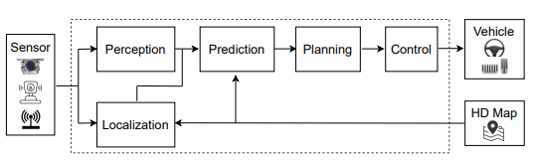
AUTOMATED DRIVING SYSTEM (ADS)
Consumes real-time sensor data
Cameras, RADAR, LiDAR, GPS, …
Localization using HD Maps
Perception: Obstacles, traffic signs, …
Prediction: trajectories of perceived objects
Planning: trajectories for the Ego vehicle
Control: Control commands (steer, brake/throttle)

Slide 15
SAFETY ASSESSMENT
Assessment across entire operational design domain (ODD) of the system
ODD: Operating conditions under which a given ADS is designed to function
Component-level assessment
Individual components
E.g.: Object detection part of the perception component
System-level assessment
Functionalities backed by multiple components and interaction among them
E.g.: reach a destination without any collisions navigating through intersections
Two assessment approaches are complementary

Slide 16
CONVENTIONAL TESTING VS SBT
Generic testing
Ego vehicle drives on public roads with uncontrollable and unpredictable traffic scenarios
Inefficient in covering rare events/challenging scenarios
Scenario-based testing
Testing challenging scenarios
Gain confidence on functionality and safety

Slide 17
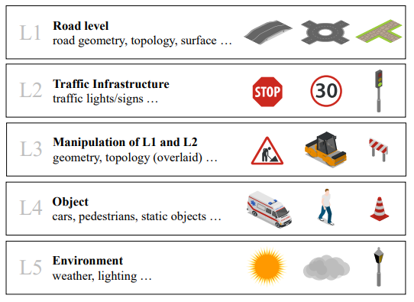
LAYERED SCENARIO MODEL

Slide 18
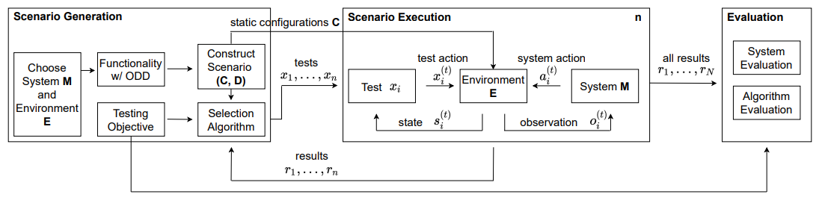
SCENARIO-BASED TESTING WORKFLOW
Example: ACC functionality in highway environments
Static config. C: map, background object behavior; Searchable space D
Test objective: find scenarios causing Ego vehicle collision

Slide 19

SCENARIO PARAMETERS
Layer 1
Road layout parameters: curvature, ramp, surface friction, number of lanes
Layer 4
Object behaviors: control at initialization, control for activated behavior, and control at every step
Layer 5
Environmental conditions like weather and lighting
Rain, fog, snow, cloud, wind intensity, wetness, snow, sun angle, light intensity

Slide 20
TESTING OBJECTIVES
SPECIAL SCENARIOS SEARCH
Goal is to find scenarios satisfying specific properties efficiently
Finding qualified scenarios (more)
Finding scenarios with best values (severe)
Quickly finding the first qualified scenario (first)
PERFORMANCE EVALUATION
Collision rate
Task failure rate
Critical rate
Critical value
Critical boundary

Slide 21
ALGORITHMS FOR SCENARIO SEARCH
NON-ADAPTIVE
Does not access the information from the environment or system
SIMULATION-BASED ADAPTIVE
Generates a batch of test functions at a time
Passes test functions to scenario execution module to run
Leverages feedback to generate next batch
E.g.: Evolutionary algorithms, Simulated annealing, …
STEP-BASED ADAPTIVE
Generates one test function
Constantly get feedback from the environment to generate next test function
E.g.: Reinforcement learning

Slide 22
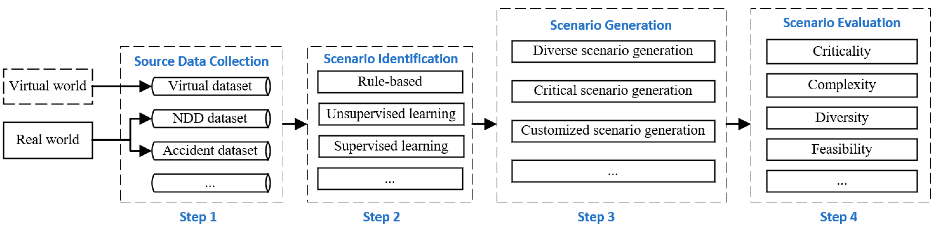
DATA-DRIVEN SCENARIO GENERATION

Slide 23
(I) SOURCE DATA COLLECTION
Natural Driving Data (NDD)
Traffic data collected in the physical world
Sensors mounted on the vehicles or physical infrastructure
Accident Data
Several databases document crash/near-crash scenarios
Virtual Data
Data from high-fidelity 3D simulators

Slide 24
(II) SCENARIO IDENTIFICATION
Source data mining
Filter out unnecessary/uninteresting scenario data
Reduce feature dimensions
Identify known and unknown scenarios in source data

Slide 25
(III) SCENARIO GENERATION
Coverage and Criticality of scenarios are crucial
Methods:
Random sampling
Combinatorial testing
Mutation testing
Reinforcement learning

Slide 26
(IV) SCENARIO EVALUATION
Criticality measure for scenarios
Trajectory: calculated using trajectories of all traffic participants
Maneuver: measure the difficulty of avoiding an accident
Energy: measure severity of crash (kinematic energy released during crash)
Uncertainty: more uncertainties the better (e.g.: road friction, velocity variance of vehicles)
Combination: integrates several metrics; multi-dimensional analysis

Slide 27
ADS SIMULATION

Slide 28
ADS TESTING
Rigorous testing essential to
Ensure robust functionality and safety
Widespread adoption
Real World
Constructed in the real world (public or closed-course)
High fidelity
Uncontrollable and unpredictable
Expensive, non-scalable, dangerous in certain scenarios
Virtual
Complement traditional methods
Repeatability and reproducibility
Scalable
Cost-effective

Slide 29
X-in-the-Loop (XIL) TESTING
Model-in-the-Loop (MIL)
Simulation on a general computing system
Software model + plant model
Software-in-the-Loop (SIL)
Simulation using compiled code
Software + plant model
Hardware-in-the-Loop (HIL)
Hybrid solution combining simulated models with real hardware components
Software + plant model + physical embedded hardware
Virtual Hardware-in-the-Loop (VHIL)
Software + plant model + virtual embedded hardware

Slide 30
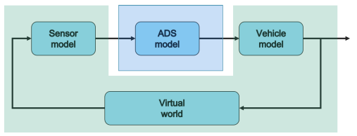
ADS SIMULATION CONTENT
Static Environment Simulation
Dynamic Environment and Behavior Simulation
Traffic Flow Simulation
Sensor Simulation
Vehicle Dynamics Simulation

Slide 31

STATIC ENVIRONMENT SIMULATION
Composed of 3D models of
Terrains
Road network structure
Road type
Buildings
Vegetation
Traffic sign

Slide 32
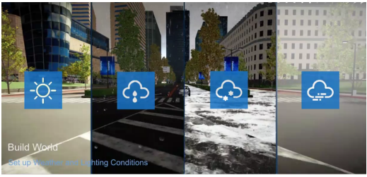
DYNAMIC ENVIRONMENT & BEHAVIOR SIMULATION
Microscopic
Vehicles
Pedestrians
Weather conditions
Lighting
Macroscopic – traffic flow
Interaction of traffic participants with the Ego vehicle (vehicle-under-test)

Slide 33
DYNAMIC ENVIRONMENT & BEHAVIOR SIMULATION
COLLISION MODELS
Low-fidelity
Using relative velocity and heading angle to directly estimate the damage of the collision
Medium-fidelity
Using involved agent’s kinematic to determine acceleration and classify the damage
High-fidelity
Using FEM to precisely compute forces exerted during the collision

Slide 34
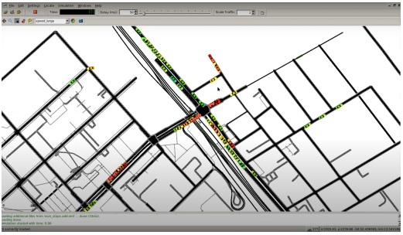
TRAFFIC FLOW SIMULATION
Studies the behavioral interaction between each vehicle on the road and the Ego vehicle
At macro level, continuous compressible fluid composed of a large number of vehicles, focusing on aggregated variables such as average speed and average density

Slide 35
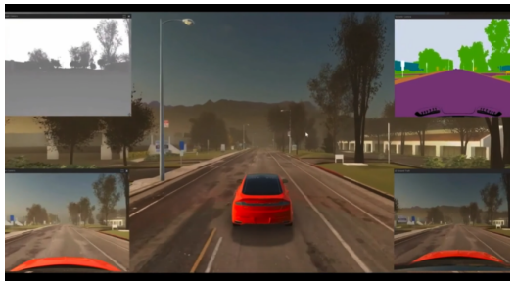
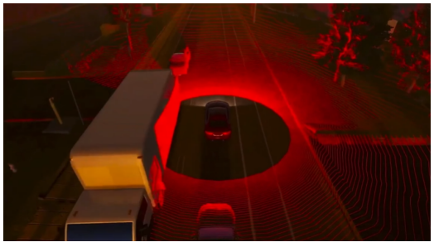
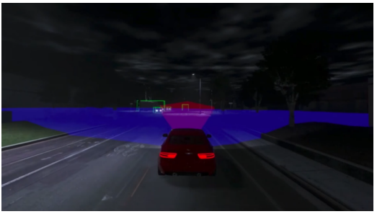
SENSOR SIMULATION
Enable ADS to perceive its environment, identify and classify participants and the behavior
Types:
Camera
RADAR (short and long range)
LiDAR
Positioning and properties influence field-of-view

Slide 36
SENSOR SIMULATION
FIDELITY
Low-fidelity
Black-box models or object list (retrieved directly from simulation environment)
Doesn’t cover statistical aspects (false positives/negatives) related to perception
Cover basic aspects such as field of view (FOV) and occlusions
Medium-fidelity
Grey-box
Model effect of traffic objects’ shape and texture, atmospheric degradation
High-fidelity
White-box or physics-based
Ray tracing/rasterization to render 3D simulation environment

Slide 37
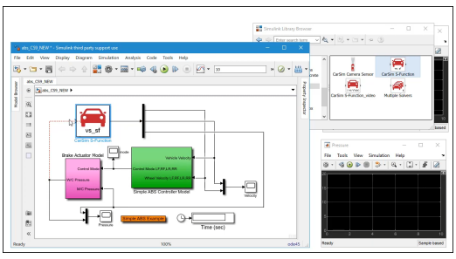
VEHICLE DYNAMICS SIMULATION
Reflect physical properties of vehicle
Degrees of Freedom (DoF)
Motion control
Center of mass and inertial characteristics
Suspension
Braking
Acceleration/Deceleration
Configure model parameters based on test objectives

Slide 38
VEHICLE DYNAMICS SIMULATION
FIDELITY
Low-fidelity
Point-mass or kinematic models
Used for controller synthesis or microscopic traffic studies
Medium-fidelity
Chassis models with linear or non-linear tires
Used for synthesis of model predictive controller
High-fidelity
Multi-body models, including suspensions geometry, chassis compliance, engine mounting stiffness and damping characteristics, driveline dynamics, tire contact points, …

Slide 39
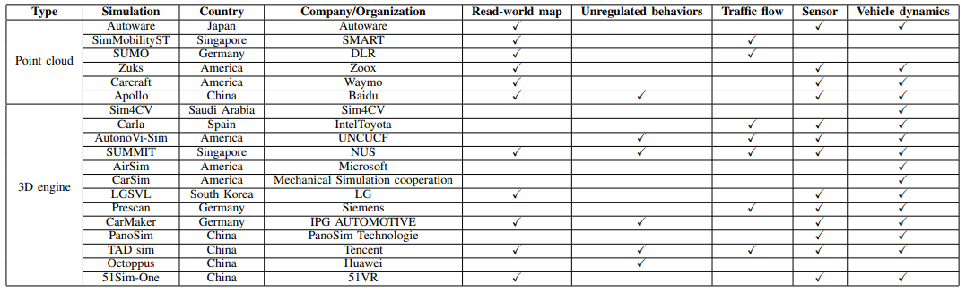
SIMULATION PLATFORMS

